Slide 1
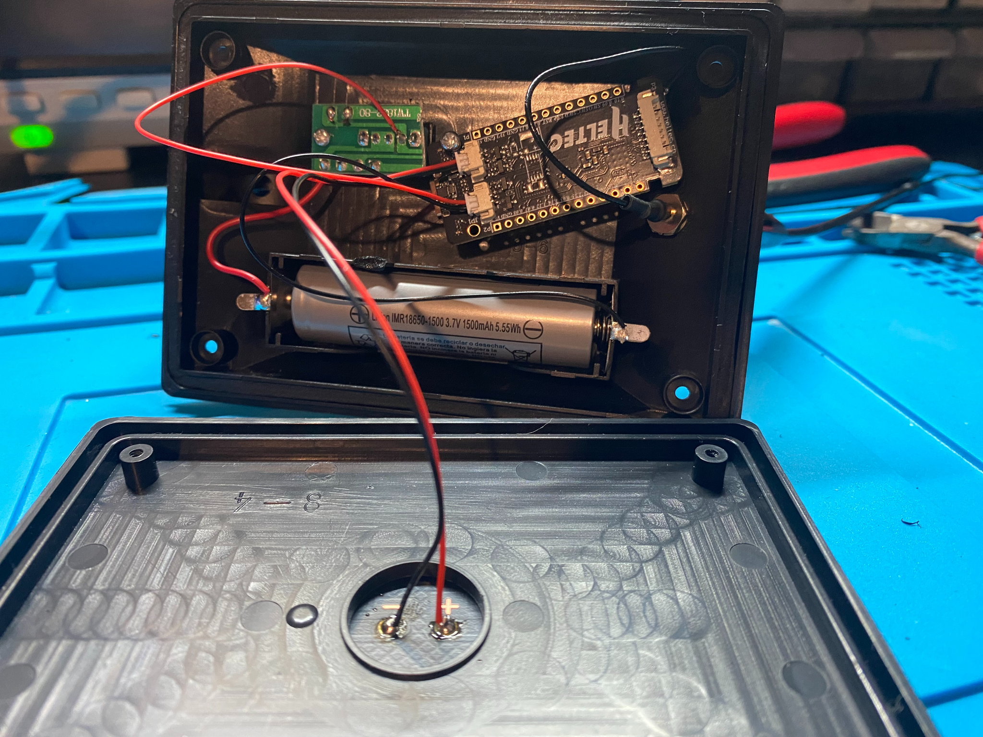
meshtastic essentials
a free workshop held on
2026 mm xx
at Prototype North Oakland
by the Protomesh Collective

Slide 2
How much do you already know?
0
"Mesh-what?"
1
Heard the name
2
Read about it
3
Own a device
4
Sending messages
5
Building solar nodes
SLIDE SHAMELESSLY STOLEN FROM SUNBEAR
Notes:
FACILITATOR NOTES — FIVE-FINGER POLL
"Hold up fingers — zero to five. Zero means you've never heard of Meshtastic. Five means you're already building solar-powered nodes in your backyard."
Read the room. If almost everyone is at 0-1, you know to keep the presentation basics very foundational. If you have some 3-4s, you can recruit them as table helpers during setup.
This also gives you a sense of who might be good candidates for the "share what you learned" follow-up role.
WHO HAS THE APP INSTALLED?

Slide 3
what do you think Meshtastic is?
shout it out! no wrong answers
SLIDE SIMILARLY STOLEN FROM SUNBEAR

Slide 4
What is Meshtastic?
Free and open source communications technology
  Text messaging over radio
  Decentralized, encrypted, and hyperresilient
The nodes themselves are the network
  Messages hop from node to node
  More nodes increase network coverage
Uses LoRa (“LOng RAnge”) radio waves
  900-930 MegaHertz band centered on 915 MHz (33cm wavelength)
  ½ to 1 mile of range with stock antenna
Notes:
:A typical human eye will respond to wavelengths from about 380 to about 750 nanometers.^{[3]} In terms of frequency, this corresponds to a band in the vicinity of 400–790 terahertz. These boundaries are not sharply defined and may vary per individual.^{[4]} Under optimal conditions, these limits of human perception can extend to 310 nm (ultraviolet) and 1100 nm (near infrared).^{[5][6][7]} https://en.wikipedia.org/wiki/Visible_spectrum

Slide 5
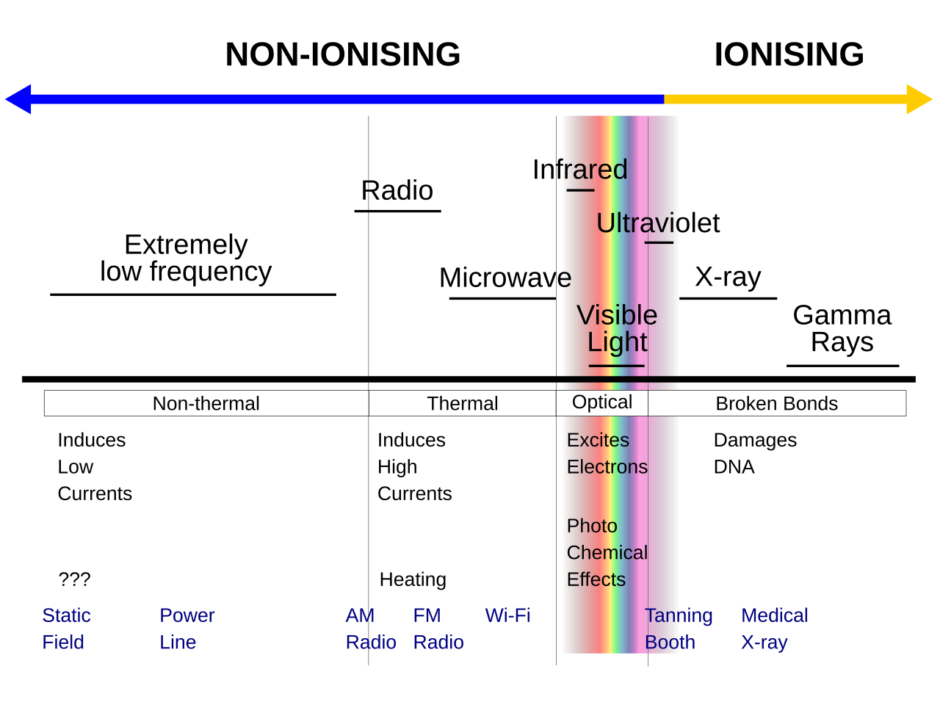
The Electromagnetic Spectrum
(from Wikipedia)
Notes:
https://en.wikipedia.org/wiki/Ionizing_radiation#/media/File:EM-spectrum.svg

Slide 6
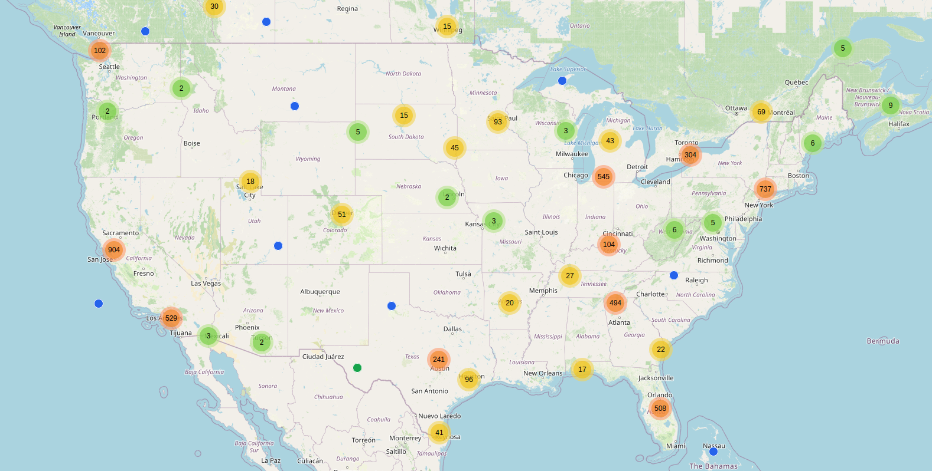
United States Coverage Map (February 2026)

Slide 7
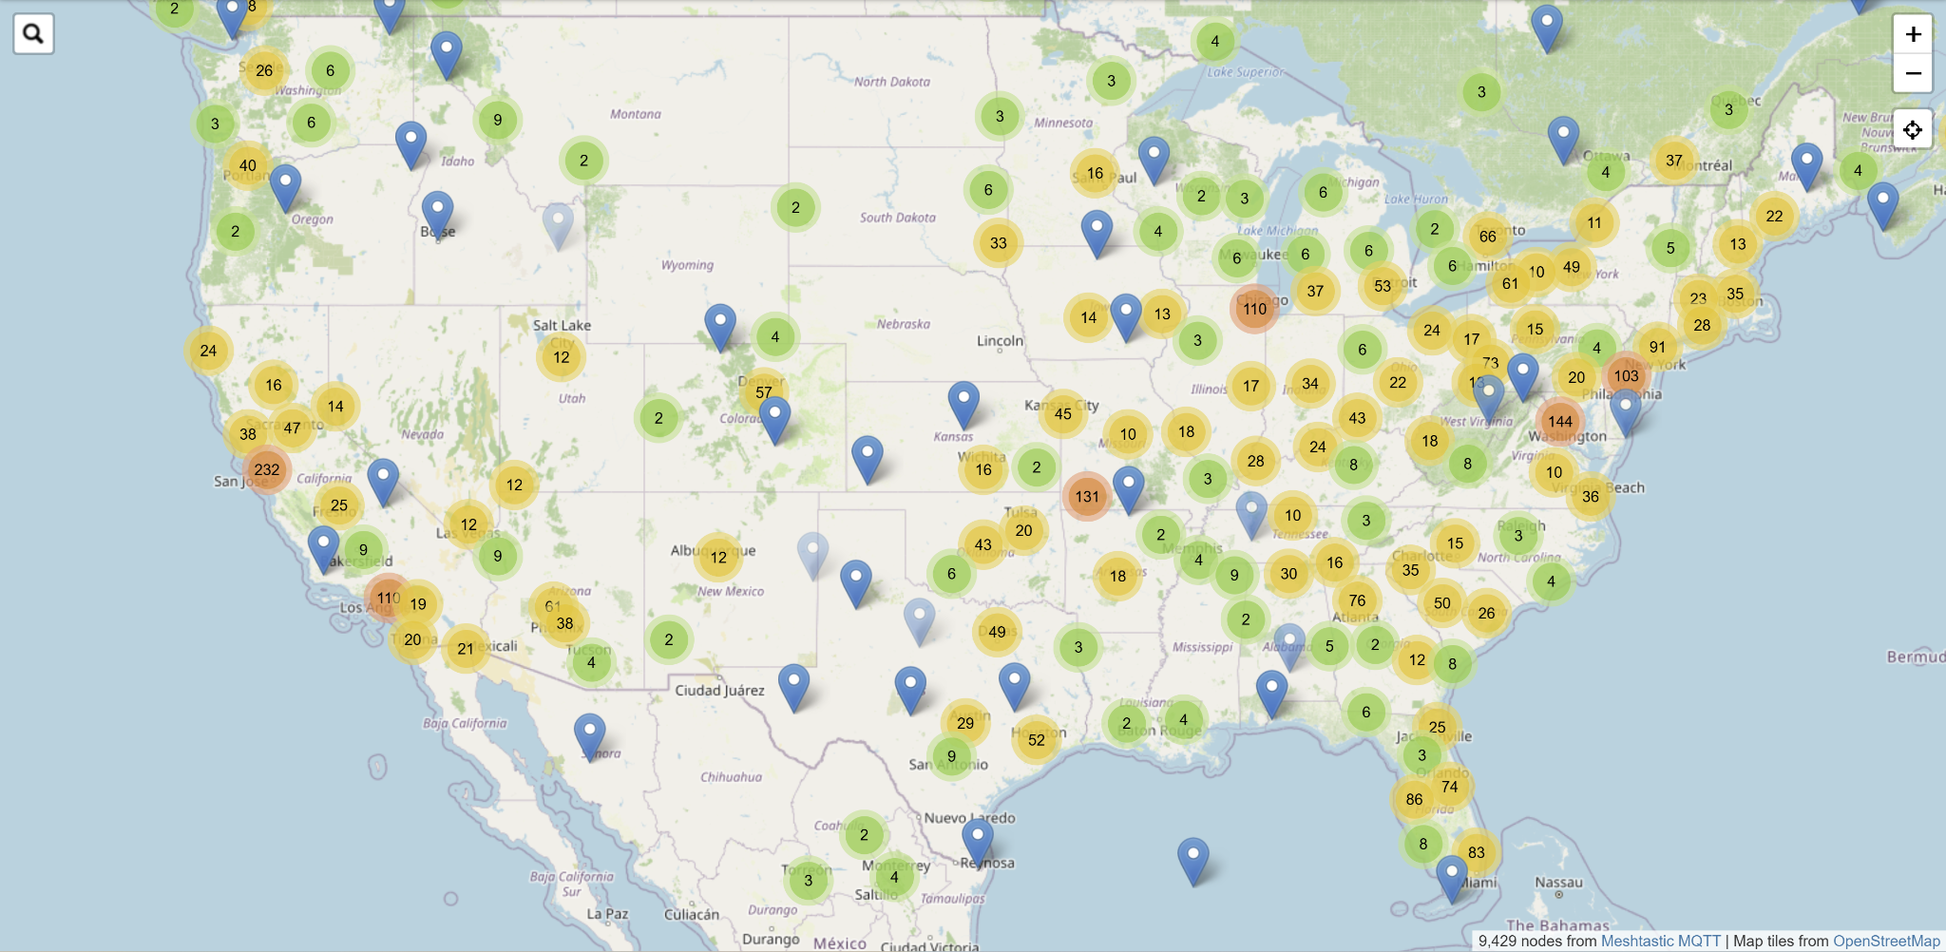
United States Coverage Map (August 2026)

Slide 8
Why Meshtastic?
Hyperresilient - it works when nothing else does
  Doesn’t need cell signal, Internet, or even the power grid
  Ideal for disaster recovery AND remote sensor deployments
Decentralized and community-driven
  Don’t need to wait for or pay for centralized network infrastructure
  Volunteer/open-source projects bring out the best of people and their skills
  “Pittsburgh has the best Mesh we’ve seen” - Anthrocon 2026
End-to-end encrypted
  Meshtastic’s cryptosystem is NOT as good as Signal’s!
  But, Signal gets to assume a reliable network, and ham radio doesn’t allow encryption at all
  Encryption is convivial technology that enables experimental projects to become practical comms

Slide 9
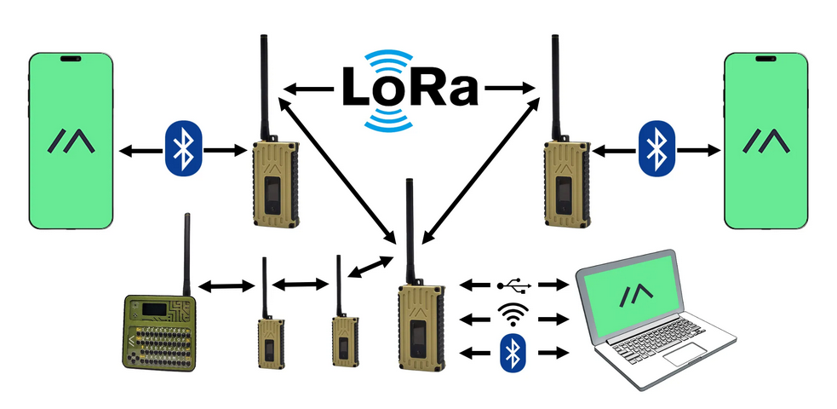
How does the Meshtastic network work?
(US) Meshtastic nodes talk to each other over (915 MHz) LoRa radio waves.
We usually talk to nodes via Bluetooth, but we can also use USB or sometimes Wifi.
Notes:
https://en.wikipedia.org/wiki/Ionizing_radiation#/media/File:EM-spectrum.svg

Slide 10
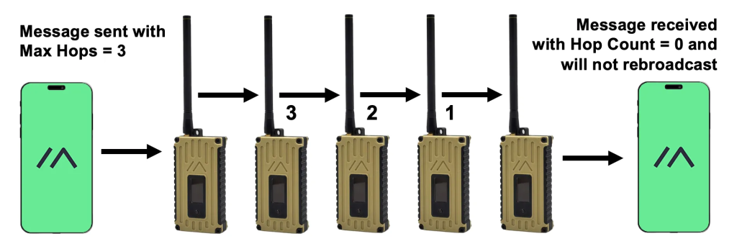
How do Meshtastic messages travel?
Your phone pairs to the device over bluetooth
You send your text message to the device
The device sends the message to the network over LoRa
The nodes in the network repeat the message a certain number of hops, hopefully reaching the recipient
Their device sends the message over Bluetooth to their phone

Slide 11
Public-Private Key Cryptography
Asymmetric encryption generates a pair of two keys
  Public key -> Shared publicly, associated with your online persona
  Private key -> DO NOT SHARE, Anyone with this key can decrypt all of your messages
Encrypt with Public Key -> Decrypt with Private Key (Secure Comms)
Encrypt with Private Key -> Decrypt with Public Key (Digital Signatures)
Asymmetrical cryptography allows you to securely send and receive messages, simply by knowing each others public keys.

Slide 12
Cryptography Examples
You encrypt a message with someone else’s public key and send it to a server. Only they can decrypt that message with their private key.
You encrypt a message with your private key and send it to a server. Anyone with your public key can decrypt the message, and knows that you’re the only person who could have made it.
You encrypt a message with BOTH your private key and someone else’s public key. You both know that you are the only ones who can read the message. They know that you must have sent it, not an imposter.

Slide 13
There Is No Perfect Technology
Technology Name | Technology Description | Pros | Cons | Best For
LoRa | Method for encoding data in radio waves of particular frequencies (uses 915 MHz in US, 868 MHz in Europe) | Uses frequency bands that don’t require operator licensing, good at connecting hard-to-reach locations | Low bandwidth means slow data speeds | Enabling “meshnet” projects such as Meshtastic and Meshcore
Meshtastic | LoRa-based decentralized encrypted text comms (easy to use) | Extremely easy to set up, works well when few nodes around | Transmits data quite inefficiently | Building a LoRa meshnet where none exists
Meshcore | LoRa-based decentralized encrypted text comms (efficient) | Faster, more reliable, longer range than Meshtastic | More difficult to configure, needs dedicated routing nodes AND client nodes | Making an established LoRa meshnet more efficient
Signal | End-to-end encrypted text and voice app | Most secure cryptosystem accessible to the average user | Needs Internet and/or cell network to operate | Transmitting info that needs to stay encrypted for 2+ years*
Ham Radio | Hyperresilient voice/data comms on other frequency bands | Gear more powerful than Meshtastic, can transmit more info faster, long-established community | Requires licensing, encryption forbidden, gear more expensive | Assisting official/state-funded disaster recovery efforts
...but we keep getting closer!

Slide 14
Real-World Examples
Asheville, North Carolina
  After Hurricane Helene destroyed large chunks of Asheville’s infrastructure, people were able to use combinations of Meshtastic and GMRS radios to spread information when the cell towers were out. There are still 65 active nodes in the Asheville portion of the North Carolina Mesh Network.
Redtail Resilience Network
  Enabling both hyperlocal community organization in Pittsburgh and disaster-recovery volunteer coordination from East Palestine to New Orleans
  Led in part by Sunbear, who also helps lead WPAmesh
Ukraine
  Meshtastic is being used for both combat and non-combat roles where access to encrypted radios is limited. Meshtastic pairs well with ATAK systems that allow soldiers to have real-time maps

Slide 15
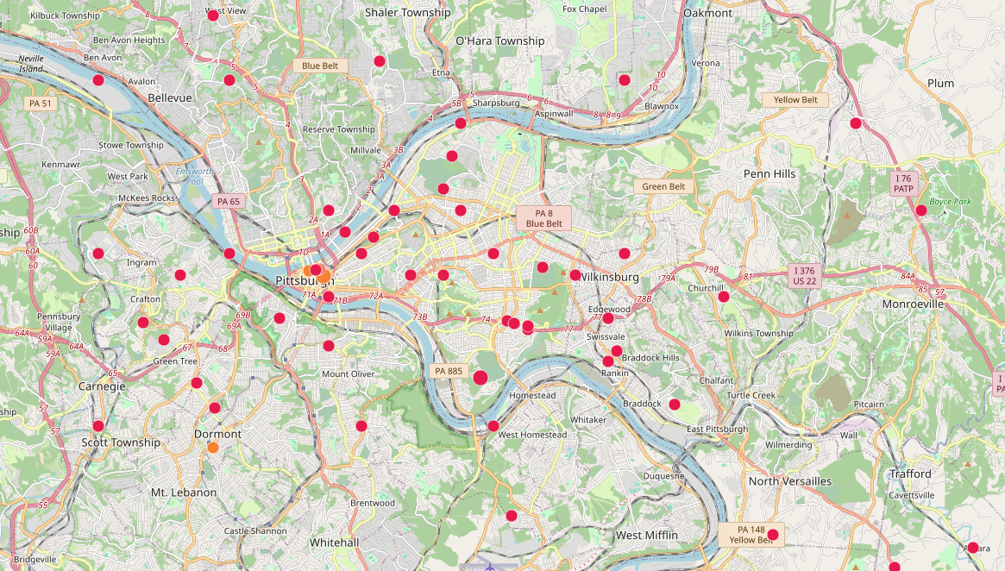
Local Coverage Map (February 2026)

Slide 16
Potential Downsides
Startup costs, and DIY assembly increase friction for mass adoption
  Even the cheap devices still cost around $30
Requires line of sight and an established network
This technology is still new, and the community is rapidly evolving, but there will be bugs in the meantime
Meshtastic’s cryptosystem is weaker than Signal’s
Low bandwidth – can only handle text messages, no voice or image
Bottomline: This isn’t a cell phone or Signal replacement, it won’t always “just work”, but if you practice using it, it can work when nothing else does.

Slide 17
Western Pennsylvania Mesh
“Best Meshtastic network in the country” - Anthrocon
516 nodes
  328 as of February (57% growth in 6 months/250% annual growth rate
Handles approximately 7000 messages every 24 hours
  Same as February
They have a website (wpamesh.net) and a Discord
14.6% channel util and 3.36% airtime
  Channel util is all traffic, airtime is potential useful (human to human) traffic
    Meshcore utilizes channel much more efficiently than Meshtastic
  “12% network uptime” on February slides
36 routers (18 in February)

Slide 18
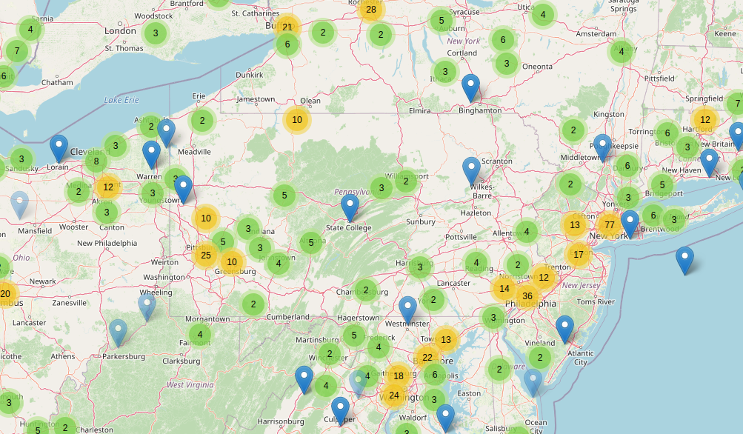
Pennsylvania Coverage Map (February 2026)

Slide 19
Other things you can do, from simple to complex
Check out the ‘best mesh in the country’ (Anthrocon ‘26) at https://wpamesh.net/
  On that note, check out the Meshtastic traffic from Anthrocon ‘26, displayed then and now at https://awoo.corg.ski/chat
Join the WPAMesh Discord to keep up with the latest and greatest
Acquire a handheld node and learn how to use it
  Protomesh NOMAD open source design ($30 in parts as of Sep ‘26)
Become the Meshtastic expert for your family/friends/community/organization
Build solar-powered repeater nodes and put them up high
  Protomesh HACKERSBLOOM open source design ($30 in parts as of Sep ‘26)
  Free SOLDERDAY workshops every 3rd Saturday 1-3 PM at Prototype x Oakland
Join the Protomesh Collective to help educate and equip your neighbors in Meshtastic technology

Slide 20
Questions?

Slide 21
Even More Resources!
Low-cost DIY Meshtastic board: https://github.com/gargomoma/fakeTec_pcb
An honest assessment of the limitations of Meshtastic’s cryptosystem: https://meshtastic.org/docs/overview/encryption/
Minneapolis Mesh Map: https://monitor.mspmesh.org/
Western Pennsylvania Mesh Map: https://map.wpamesh.net/map
Protomesh Collective Resources: https://github.com/witchofthewires/protomesh

Slide 22
Thank You!

